Slide 1
MOBILITY-AWARE ENERGY MINIMAL TASK OFFLOADING WITH DELAY CONSTRAINTS IN MOBILE EDGE COMPUTING ENVIRONMENT
Final Year Project presentation
Project guide: Dr R.R.Rout
By
Vajjhala V V S Srirama Savitru(167264)
P V Karthik Reddy(167245)
Raja Chitawle(167250)

Slide 2
Mobile Edge Computing
Servers are deployed at Base Stations – MEC servers
Mobile users can now offload tasks to nearby MEC servers
Advantages
User view: Applications are faster now, better battery life
Edge Service provider view: Less operational cost
Challenges
Task view: Quality of service – meeting task deadlines
Infrastructure view: Energy efficiency of the system

Slide 3
Evolution
Cloud computing
Mobile cloud computing
Collaborative Edge computing
Mobile Edge computing -> Energy Consumption and time delay
User Mobility consideration
Immense computing
Large Delay
Better battery life
Large delay (QoS issue)
for offloading is low
For wireless communication and computation is important
Hierarchical offloading

Slide 4
Existing Works
S.No | Model | Problem
1 | CEC, N-N Task Assignment | Energy Optimal task offloading (Hungarian Algorithm)
2 | MEC with D2D communication | Energy Minimal Delay constrained task offloading
3 | MEC, mobility-aware (SGAN) | Task offloading to cloud or Edge in real-time
4 | MEC, mobility-aware (RWP) Melbourne-CBD dataset | Mobility aware Migration and Allocation
5 | MEC, mobility-aware (1 server at each point in user’s trajectory) | Delay minimal task offloading

Slide 5
System Model

Slide 6
System Model
Mobile Edge Network(MEN) consist of set of Base Stations(BS) and Central Base Station(CBS).
Each BS is equipped with an MEC server.
CBS acts as a controller for all BSs in the MEN.
Each MEC server is capable of receiving, executing and transmitting task.
We considered the mobility of users across the area under MEN.
At any time, an user may be under the coverage range of multiple BSs.
Assumption: At time t=0, all users offload their tasks to nearby MEC servers and start moving

Slide 7
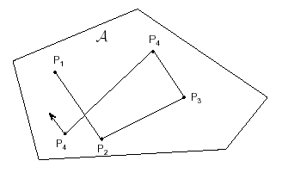
User Mobility
Random Waypoint Mobility Model
The user selects a random destination in the simulation area and a random speed between a given range.
The user moves to the direction of destination and again pauses for a fixed period before choosing another random location and speed.
This behaviour is repeated for the length of the simulation.
Random Walk
Similar to Random Waypoint Model where waiting time at each step is removed.

Slide 8






Server set 3
Server set 2
Server set 1
MEC7
MEC25
MEC2
MEC3
MEC9
MEC1
MEC30
U1
Step 2
Step 3
Step 1
U2

Slide 9
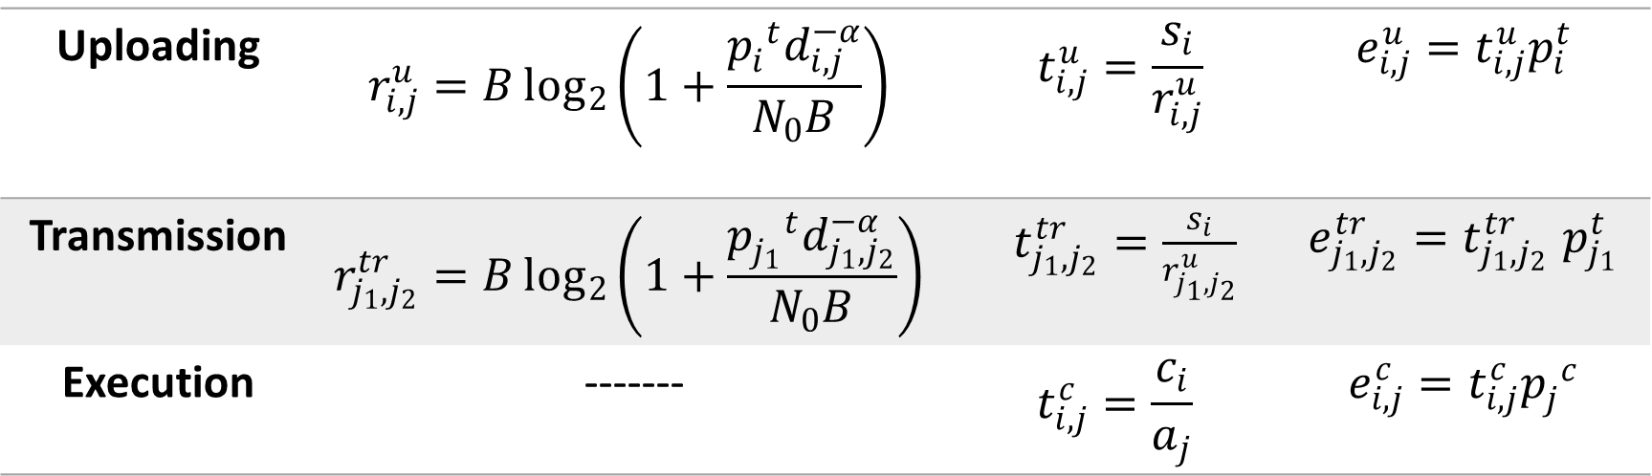
Formulation
Uploading | $$r_{i,j}^{u}=B\log_{2}\left(1+\frac{{p_{i}^{ }}^{t}d_{i,j}^{−α}}{N_{0}B}\right)$$ | $$t_{i,j}^{u}=\frac{s_{i}}{r_{i,j}^{u}}$$ | $$e_{i,j}^{u}=t_{i,j}^{u}p_{i}^{t}$$
Transmission | $$r_{j_{1},j_{2}}^{tr}=B\log_{2}\left(1+\frac{{p_{j_{1}}^{ }}^{t}d_{j_{1},j_{2}}^{−α}}{N_{0}B}\right)$$ | $t_{j_{1},j_{2}}^{tr}=\frac{s_{i}}{r_{j_{1},j_{2}}^{u}}$ | $$e_{j_{1},j_{2}}^{tr}{=t}_{j_{1},j_{2}}^{tr}p_{j_{1}}^{t}$$
Execution | ------- | $$t_{i,j}^{c}=\frac{c_{i}}{a_{j}}$$ | $$e_{i,j}^{c}=t_{i,j}^{c}{p_{j}^{ }}^{c}$$

Slide 10
Problem Statement
“Mobility-aware energy minimal task offloading with delay constraints in mobile edge computing environment”
EXPLANATION:
Optimization: Energy Minimal
Constraint: Task deadline
Environment: Users are moving in MEN consisting of several MECs

Slide 11
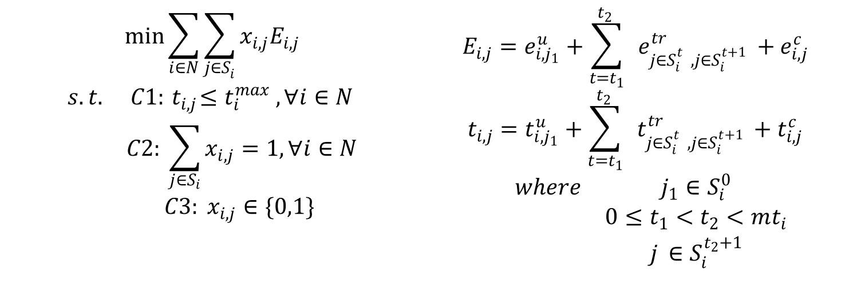
Formulation
$$\begin{aligned}\begin{matrix}\min{\sum_{i∈N}{\sum_{j{∈S}_{i}^{ }}{{x_{i,j}E}_{i,j}}}} \\ \begin{matrix}s.t. & C1:{ t}_{i,j}≤t_{i}^{max} , ∀i∈N \\ & C2: \sum_{j∈S_{i}}{x_{i,j}}=1,∀i∈N \\ & C3: x_{i,j}∈\{0,1\} \end{matrix} \\ \end{matrix}\end{aligned}$$ | $$\begin{aligned}E_{i,j}=e_{i,j_{1}}^{u}+\sum_{t=t_{1}}^{t_{2} }{ }e_{{j{∈S}_{i}^{t_{ }}}_{ },j{∈S}_{i}^{{t+1}_{ }}}^{tr}+e_{i,j_{ }}^{c}\end{aligned}$$ $$\begin{aligned}t_{i,j}=t_{i,j_{1}}^{u}+\sum_{t=t_{1}}^{t_{2} }{ }t_{{j{∈S}_{i}^{t_{ }}}_{ },j{∈S}_{i}^{{t+1}_{ }}}^{tr}+t_{i,j_{ }}^{c}\end{aligned}$$ $$\begin{matrix} & \begin{matrix}where & j_{1}∈S_{i}^{0} \\ & 0≤t_{1}<t_{2}<mt_{i} \\ & j_{ }∈S_{i}^{t_{2}+1}\end{matrix}\end{matrix}$$

Slide 12
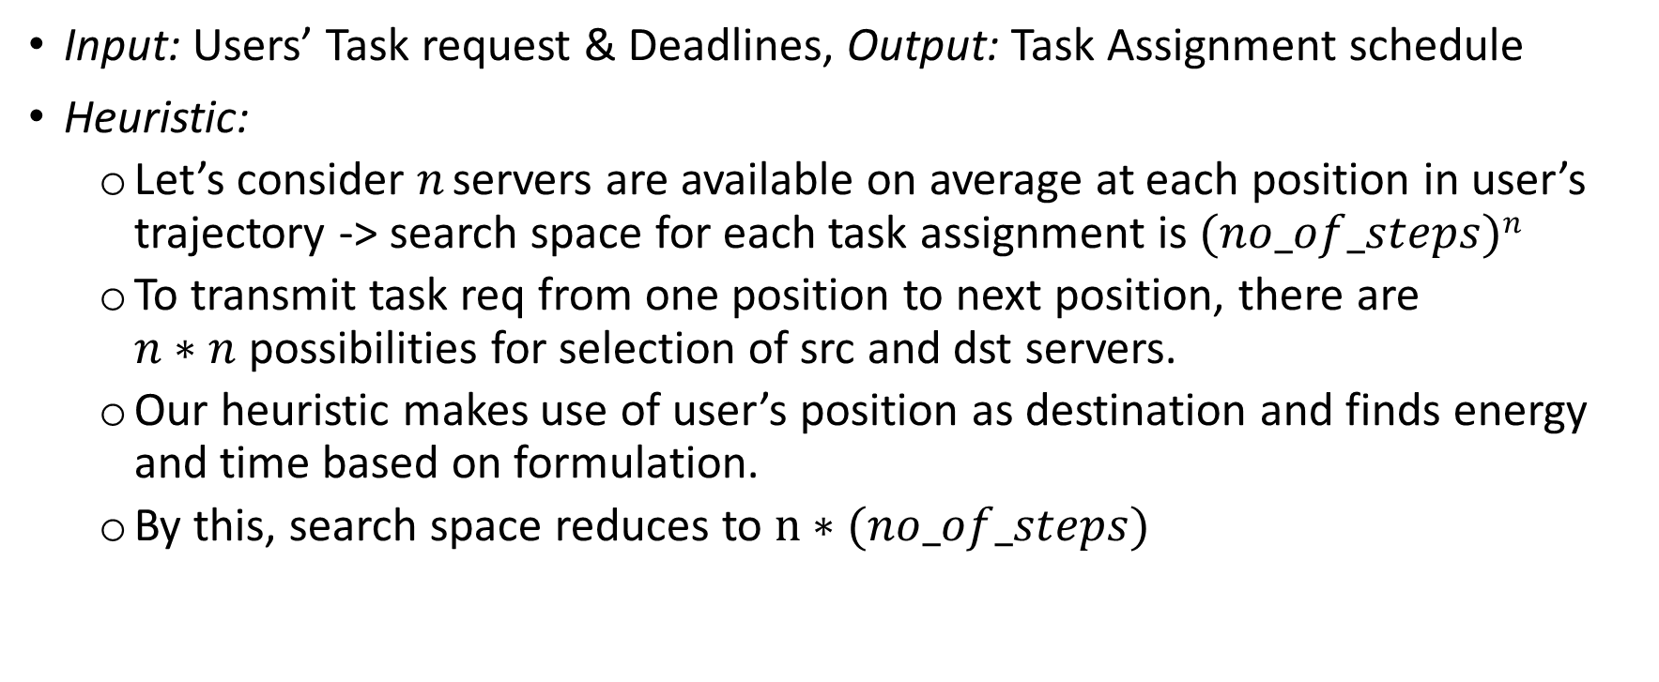
Algorithm
Input: Users’ Task request & Deadlines, Output: Task Assignment schedule
Heuristic:
Let’s consider $n$servers are available on average at each position in user’s trajectory -> search space for each task assignment is $(no_of_steps)n$
To transmit task req from one position to next position, there are $n∗n$possibilities for selection of src and dst servers.
Our heuristic makes use of user’s position as destination and finds energy and time based on formulation.
By this, search space reduces to $n∗(no_of_steps)$

Slide 13
Algorithm
Steps :
At each position in the user’s trajectory:
Find server to transmit task request to servers in user’s next position using heuristic described earlier.
Find total energy i.e., sum of upload, transmission and execution energies for each available server in user’s current position and remember the server having least total energy which is also satisfying deadline constraint.
The task request will be assigned to the server which is having least total energy among servers found in step 1.b
Above steps will be repeated for all users.

Slide 14
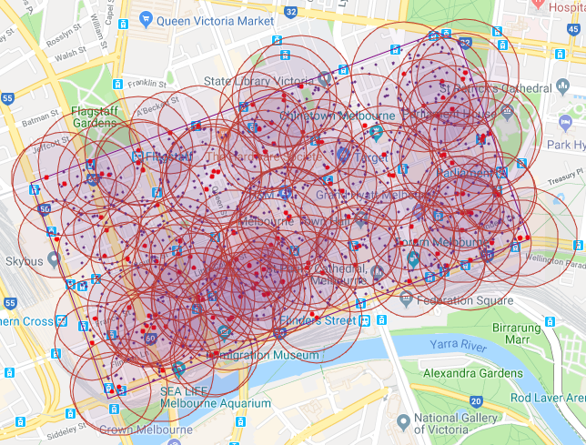
Evaluation
Dataset: Melbourne CBD dataset
Melbourne central business district comprises of 6.2km² area
This dataset consists of coordinates(Latitude, Longitude) of 126 base stations located in CBD
We converted Latitudes and Longitudes into UTM format and performed scaling and rotating to transform coordinates between [0,0] and [x,y] format.
Mobility: Random Waypoint model and Random Walk models are used for generating trajectories of users’ mobility.
System parameters: Many system parameters are randomized in certain ranges by referring to existing works.

Slide 15
Evaluation
Baseline Approaches for comparison :
Random Allocation:
A random server is chosen for transmission in case of hopping
A random server is chosen at each position of user which satisfies deadline constraint
Finally, one among the servers in above step is used for task assignment.
Local Execution:
In this approach, we consider the execution of all tasks satisfying deadline constraint inside mobile devices.

Slide 16
Results Summary
Experiment | DCEMTO’s efficiency compared to
 | Random-Allocation | Local-Execution
Task Completion(%) vs Task Deadline(sec) | 9.16% | 27.08%
Energy co(J) vs No of Users | 11.22% | -
Avg Energy co(J) vs No of Users | 10.5% | 46.5%
Energy co(J) vs Task Size(MB) | 9.55% | -
Avg Energy co(J) vs MEC server capacity(GHz) | 8.22% | -

Slide 17
Real Life Scenarios & Conclusion
Few scenarios where our model can be useful
Autonomous Vehicles
Augmented Reality Maps
MEN can be scaled down to cover a small areas area such as airport, shopping mall, library, etc.
We evaluated our algorithm on Melbourne CBD base stations dataset.
We compared our algorithm with baseline approaches like Random-Allocation and Local-Execution and observed better results.
In future, we want to explore Machine Learning based methods like Generative adversarial network for users’ trajectories and use them to evaluate our approach.

Slide 18
DEMO

Slide 19
Contribution
Group Member | Contribution
Raja | Generation of system parameters and users’ trajectories based on RWP and RW [2],[4]
Karthik | DCEMTO, Random-Allocation and Local Execution for Task Acceptance Rate Experiment[5]
Savitru | DCEMTO, Random-Allocation and Local Execution for Energy Consumption Experiment[1],[3]

Slide 20
References
J. Wang, W. Wu, Z. Liao, A. K. Sangaiah and R. Simon Sherratt, "An Energy-Efficient OffLoading Scheme for Low Latency in Collaborative Edge Computing," in IEEE Access, vol. 7, pp. 149182-149190, 2019.
Y. Kai, J. Wang and H. Zhu, "Energy Minimization for D2D-Assisted Mobile Edge Computing Networks," ICC 2019 - 2019 IEEE International Conference on Communications (ICC), Shanghai, China, 2019, pp. 1-6.
C. Wu, Q. Peng, Y. Xia and J. Lee, "Mobility-Aware Tasks Offloading in Mobile Edge Computing Environment," 2019 Seventh International Symposium on Computing and Networking (CANDAR), Nagasaki, Japan, 2019, pp. 204-210.
Q. Peng et al., "Mobility-Aware and Migration-Enabled Online Edge User Allocation in Mobile Edge Computing," 2019 IEEE International Conference on Web Services (ICWS), Milan, Italy, 2019, pp. 91-98.
Zi Wang, Zhiwei Zhao, Geyong Min, Xinyuan Huang, Qiang Ni, Rong Wang, User mobility aware task assignment for Mobile Edge Computing, Future Generation Computer Systems, Volume 85, 2018, Pages 1-8, ISSN 0167-739X,

Slide 21
Thank you

Slide 22
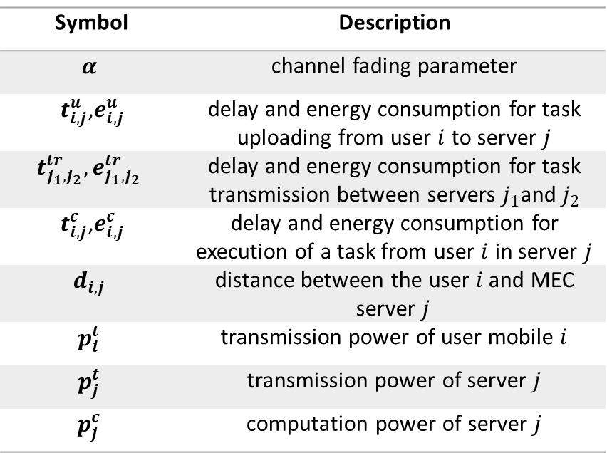
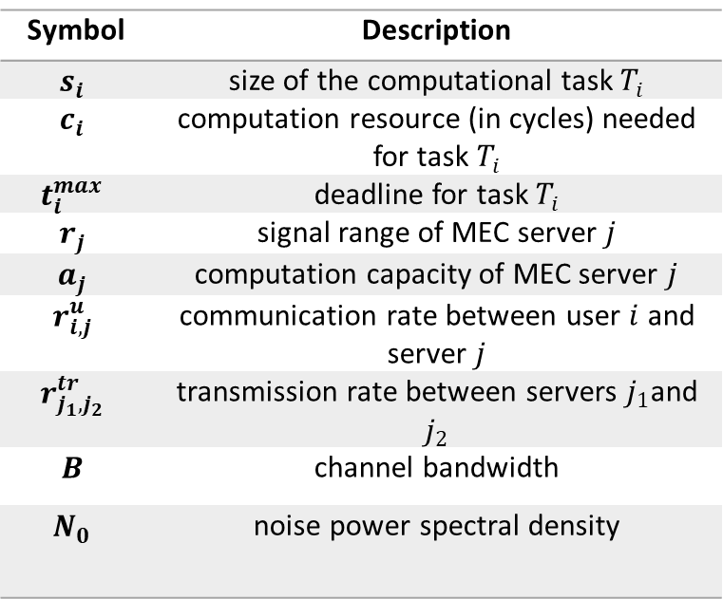
Appendix
Symbol | Description
$$s_{i}$$ | size of the computational task $T_{i}$
$$c_{i}$$ | computation resource (in cycles) needed for task $T_{i}$
$$t_{i}^{max}$$ | deadline for task $T_{i}$
$$r_{j}$$ | signal range of MEC server $j$
$$a_{j}$$ | computation capacity of MEC server $j$
$$r_{i,j}^{u}$$ | communication rate between user $i$ and server $j$
$$r_{j_{1},j_{2}}^{tr}$$ | transmission rate between servers $j_{1}$and $j_{2}$
$$B$$ | channel bandwidth
$$N_{0}$$ | noise power spectral density
Symbol | Description
$$α$$ | channel fading parameter
$t_{i,j}^{u}$,$e_{i,j}^{u}$ | delay and energy consumption for task uploading from user $i$ to server $j$
$$t_{j_{1},j_{2}}^{tr},e_{j_{1},j_{2}}^{tr}$$ | delay and energy consumption for task transmission between servers $j_{1}$and $j_{2}$
$t_{i,j}^{c}$,$e_{i,j}^{c}$ | delay and energy consumption for execution of a task from user $i$ in server $j$
$$d_{i,j}$$ | distance between the user $i_{ }$and MEC server $j_{ }$
$$p_{i}^{t}$$ | transmission power of user mobile $i$
$$p_{j}^{t}$$ | transmission power of server $j$
$$p_{j}^{c}$$ | computation power of server $j$

Slide 23
Appendix
Parameter | Value/Range
Coverage radius of BS | 70 to 100 meters
MEC’s CPU capacity | [7, 20] GHz
MEC’s computation power | [3,5] watt
MEC’s transmission power | [0.1,1] watt
Channel bandwidth | 1MHz
User’s mobility speed | 1~3 MPH
Input data size | [1,3] MB
Task CPU requirement | [1,10] GHz
Task deadline constraint | [0.1,1] sec

